Slide 1
Dragons Den Presentation
Team 2
Notes:
Say hello to relax lloyds straight away, and introduce everyone from the team. This will give Lloyds a better impression of our team as a whole

Slide 2
Firstly….
HELLO!
Notes:
Say hello to relax lloyds straight away, and possibly say something like “I’m Matt and this is <Other speaker>, and this is the rest of the development team”

Slide 3
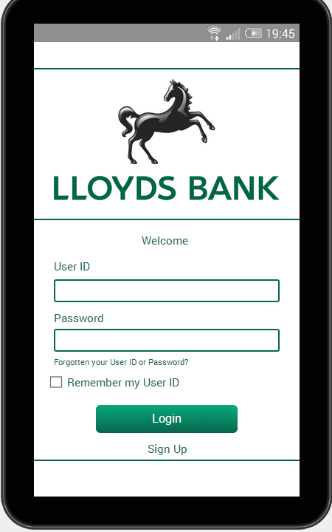
Prototype
Lloyds1
1234
Notes:
If it hasn’t already been clarified you will find a prototype of our future app in front of you or currently passing around the audience.
We’ll be glad to hear your feedback so we can improve the final product
There will be a tablet version, it will be awesome.

Slide 4

Age range
Students (18 – 25)
Notes:
Why ?
-Children don’t decide which bank they will join their parents do.
Young people at university start caring about their finances and make their first real independent decision which bank to join
If you convince these people and provide satisfying services they will stay with the bank and when they grow up and start their own families, it is likely that they will create similar accounts for their kids.

Slide 5
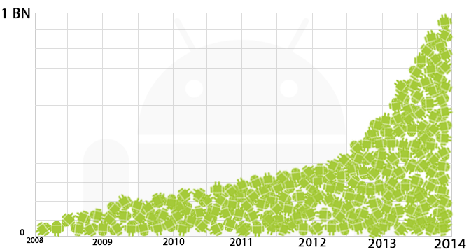
Project choice
Android App
Notes:
We choose to develop an android application because of its rapid growth in sales. Also Android is being ported on multiple devices, like TV’s tablets etc.
Majority of people in the age range for our product own multiple android devices
7 out of 8 people n our group own an android device

Slide 6
Functionality
Standard Banking Functionality -
Displays Balance.
Transfers.
Shows Lloyds offers.
Innovative Functionality –
Achievement based rewards scheme aimed at students.
A student focused finance planner (assistant).
Locates branches, ATM’s and local places to use rewards.
Notes:
We know you don’t want another standard banking app, however we also realise that your users wouldn't want to have multiple banking applications on their devices,
This is why we developed our app to provide all the basic functionality, plus some additional functionality to attract attention of our target age group

Slide 7
Security
Has login and 6-8 digit password they set up with the bank for entering first time.
When screen times out, user has to re-enter password.
Streamlines speed with security.

Slide 8
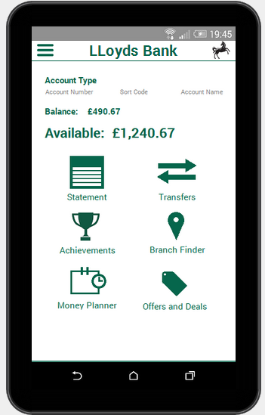
Main Screen
Notes:
Balances- Available balance is larger than the balance as this is the more important and used, on the main screen as the majority of users use app to check balance and helps avoid scouring through menu after menu.
This screen also provides links to the rest of the app’s functionality

Slide 9
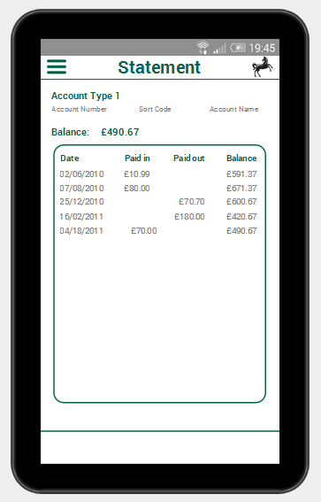
Statement
Notes:
- Providing the basic banking functionality
- We are going to gather information from the statement and use to tailor the rewards towards the users needs

Slide 10
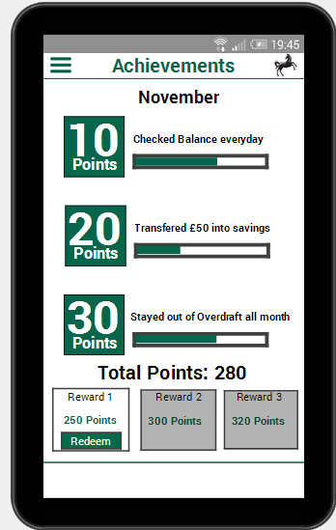
Achievements & Rewards
Notes:
Achievements – Use gamification ideas to give users points based on what is considered “good banking” behaviour. Once a user gains enough points they can redeem a reward. The challenge of trying to gain points gives the user a sense of satisfaction/achievement. Rewards will be tailored to the users spending habits from the previously shown statement screen.

Slide 11
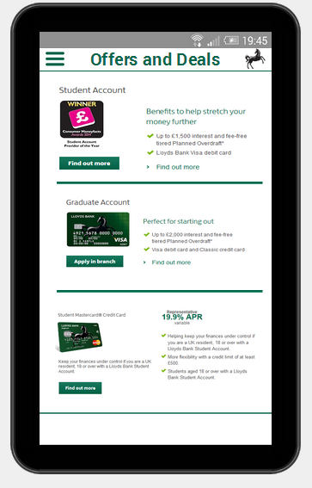
Offers and Deals
Notes:
Shows lloyds latests student accounts and deals.

Slide 12
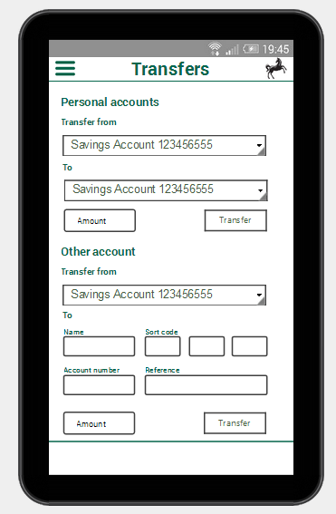
Transfers
Notes:
Allows user to transfer among personal accounts but also to an external account.

Slide 13
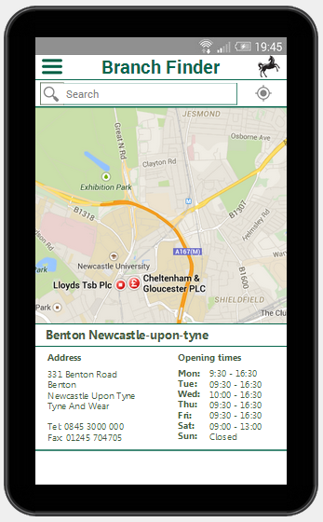
Branch Finder
Notes:
Allows the user to find a near by branch.

Slide 14
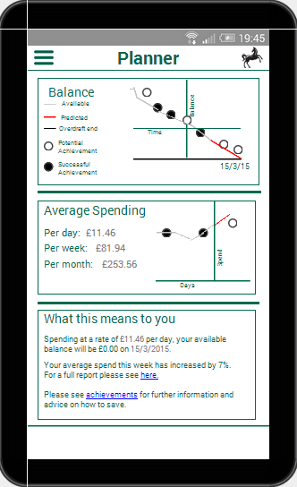
Student Planner
Notes:
Allows the user to put in their student loan, then calculates their average spend per day, week and month and uses that to predict future balances and when they with go into their overdraft.

Slide 15
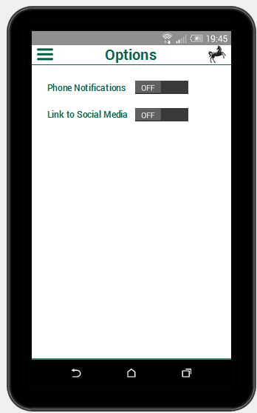
Options
Notes:
Allows the user to link their phone to social media and set notifications on/off.

